Slide 1
Energize Motor
Step by Step Guide

Slide 2

Requirements
Inverter wired
AIPEX PRO installed
CAN message configuration prepared
WARNUNG vor unkontrolierter Bewegung
Err = AIPEX diagnostic
ID 32837 'DC-bus monitoring'
Status messages - Scope online display
CAN analyser

Slide 3
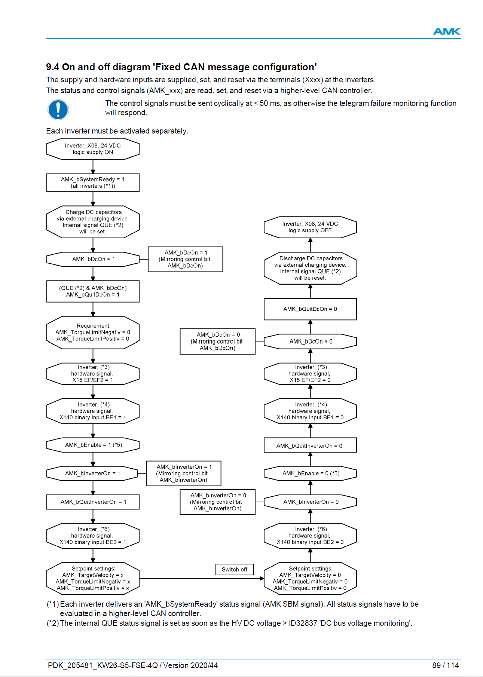
Example On (and off) diagram
Please see documentation

Slide 4


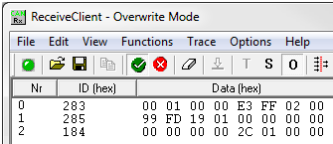

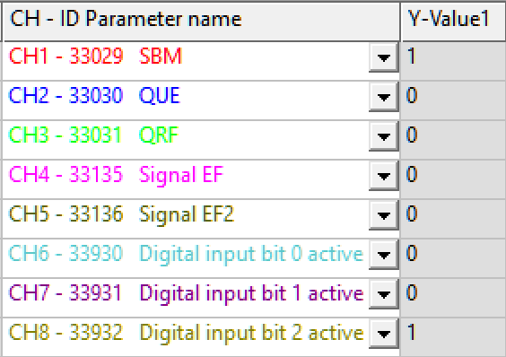




Overview Used Components
Example Project
CAN analyzer
FSE_R25_FixedCanConfig_Speed_4_Drives_V02_en
Drive FrontLeft
AIPEX PRO
Scope function
digital input signals (DI1/DI2/EF/EF2)
HV/LV

Slide 5
Control Word Formula Student 0x184
CAN analyzer
0x184 AMK_Control - Control word formula student
--
Name | Offset | Length | Hex | Meaning
AMK_bReserve | 0 | 8 | - | Reserved
AMK_bInverterOn | 8 | 1 | 0x1 | Controller enable
AMK_bDcOn | 9 | 1 | 0x2 | HV activation
AMK_bEnable | 10 | 1 | 0x4 | Driver enable
AMK_bErrorReset | 11 | 1 | 0x8 | Remove error*
AMK_bReserve | 12 | 4 | - | Reserved
Control word
formula student

Slide 6
Status Word Formula Student 0x283
0x283 AMK_Status - Status word formula student
Name | Offset | Length | Hex | Meaning
AMK_bReserve | 0 | 8 | - | Reserved
AMK_bSystemReady | 8 | 1 | 0x01 | System ready (SBM)
AMK_bError | 9 | 1 | 0x02 | Error
AMK_bWarn | 10 | 1 | 0x04 | Warning
AMK_bQuitDcOn | 11 | 1 | 0x08 | HV activation acknowledgment
AMK_bDcOn | 12 | 1 | 0x10 | HV activation level
AMK_bQuitInverterOn | 13 | 1 | 0x20 | Controller enable acknowledgment
AMK_bInverterOn | 14 | 1 | 0x64 | Controller enable level
AMK_bDerating | 15 | 1 | 0x80 | Derating (torque limitation active)
Status word formula student
--

Slide 7

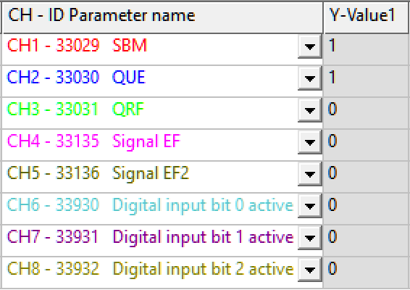

Switch On Diagram (page 1 – 4)
Inverter, 24 VDC logic supply ON
AIPEX PRO scope display
Inverter
error free
~
10 s
Inverter,
Run up
Display of a
CAN analyzer
AMK SBM = TRUE
CAN Status Word
Derating active (because DC HV
is missing)
Charge the HV circuit capacitors via an external charging device
DC voltage must be higher than value
AMK QUE = TRUE
Derating deactivated. Because the
DC HV is charged *
* provided no other derating is active for example over temperature

Slide 8


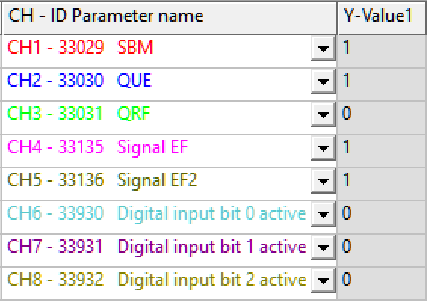
Switch On Diagram (page 2 – 3)
AIPEX PRO scope display
Display of a
CAN analyzer
CAN AMK_Control
AMK_bDcOn = 1
CAN AMK_Status
AMK_bDcOn = 1
AMK QUE & AMK_bDcOn CAN AMK_Status
AMK_bQuitDcOn = 1
Requirement CAN setpoints:
Torque limitation positive = 0
Torque limitation negative = 0
Inverter
Hardware signals X15 EF/EF2 = 24 VDC
EF, EF2 existing

Slide 9
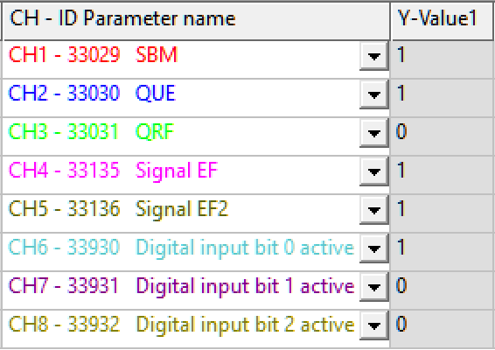

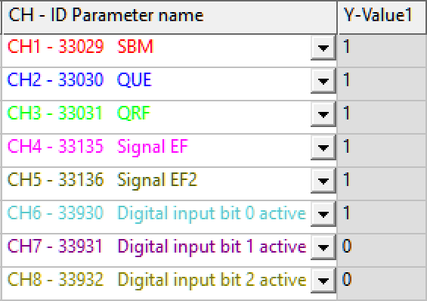

Switch On Diagram (page 3 – 4)
AIPEX PRO scope display
Display of a
CAN analyzer
Inverter
Hardware signal X140 DI1 = 24 VDC
DI1 existing
CAN AMK_Control
AMK_bEnable = 1
CAN AMK_Control
AMK_bInverterOn = 1
CAN AMK_Status
AMK_bInverterOn = 1
Motor is energized

Slide 10


Switch On Diagram (page 4 – 4)
Display of a
CAN analyzer
AIPEX PRO scope display
Inverter
Hardware signal X140 DI2 = 24 VDC
DI2 existing
Send CAN setpoints:
Torque setpoint = positive or negative value
Torque limitation positive = positive value
Torque limitation negative = negative value
AMK_TorqueLimitNegativ (0xEC FF=0x FF EC= dec -20x0.1 %Mn)
AMK_TorqueLimitPositiv (0x28 00= 0x00 28= dec 40x0.1 %Mn)
AMK_TargetVelocity (0x19 00= 0x00 19= dec 25 1/min)

